Slide 1
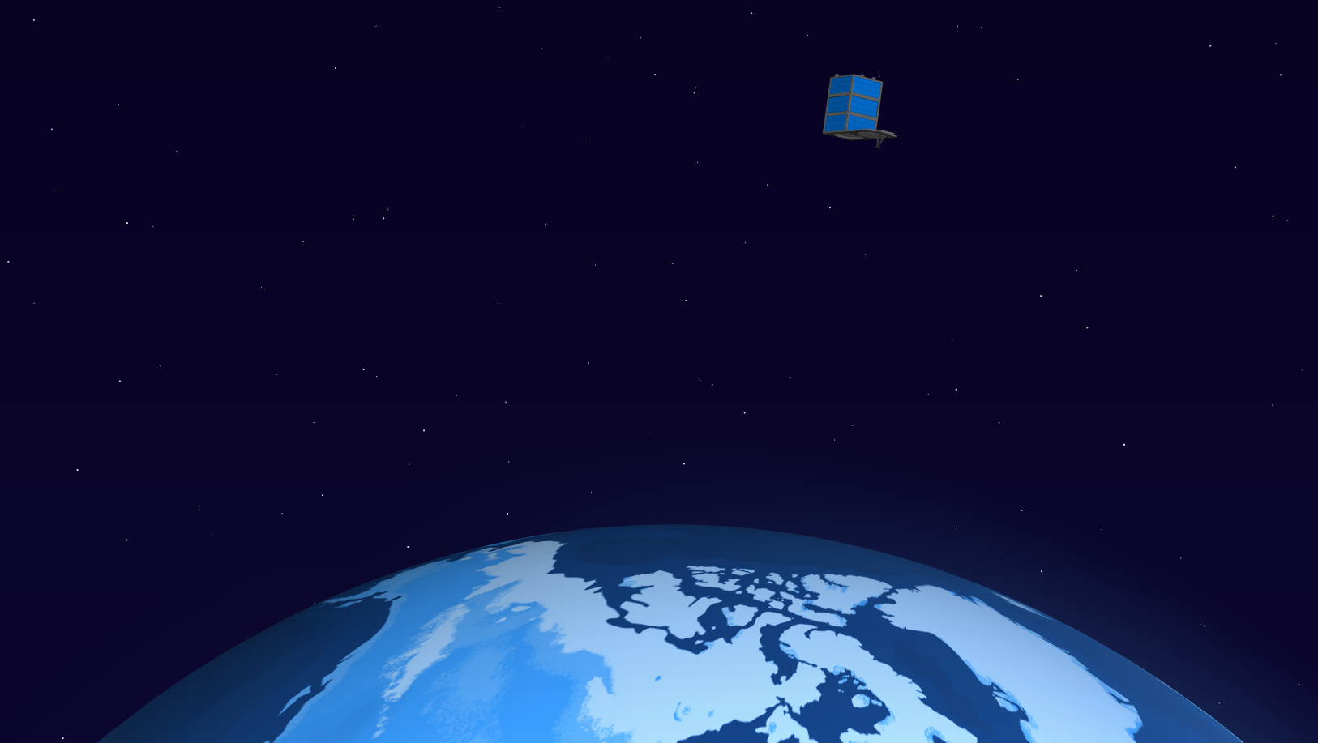

Earth Engine + SkySat
Change Detection for a Dynamic World
Kristi Bohl

Slide 2
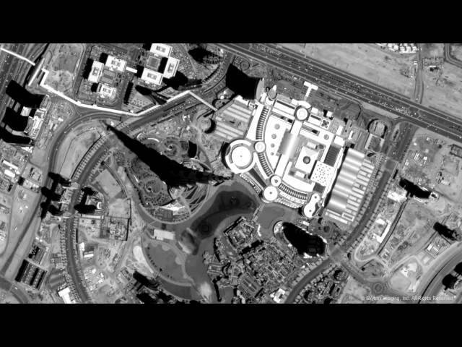

Slide 3
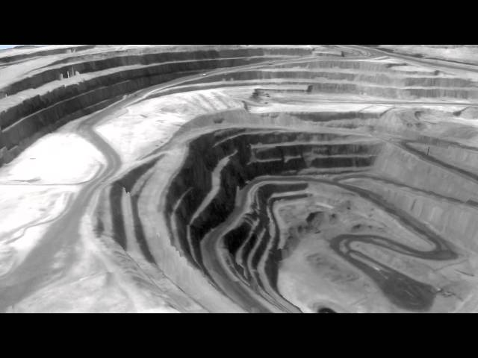

Slide 4
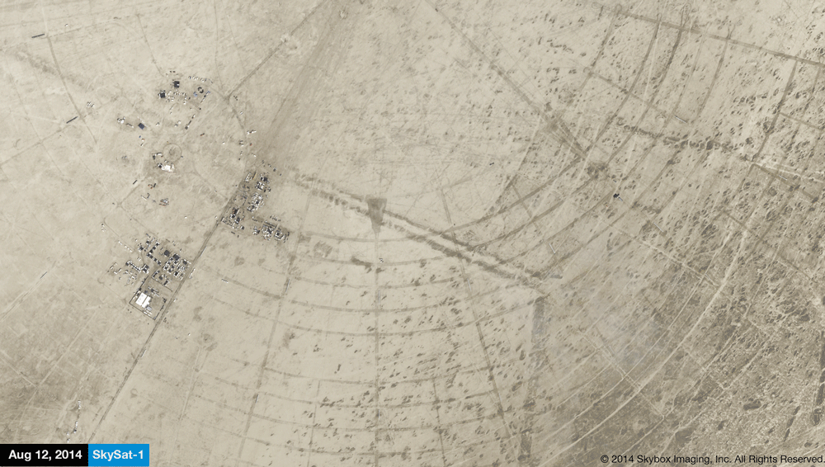
Burning Man, 2014

Slide 5
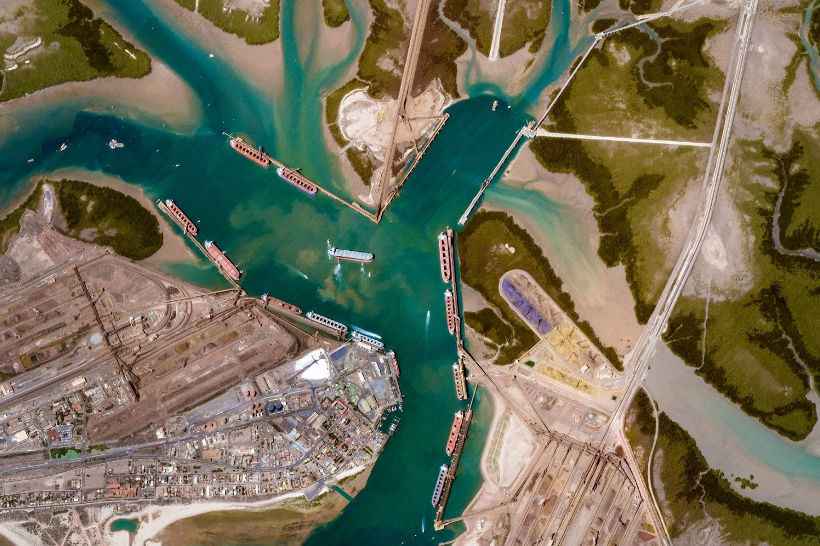
0.9 m resolution

Slide 6
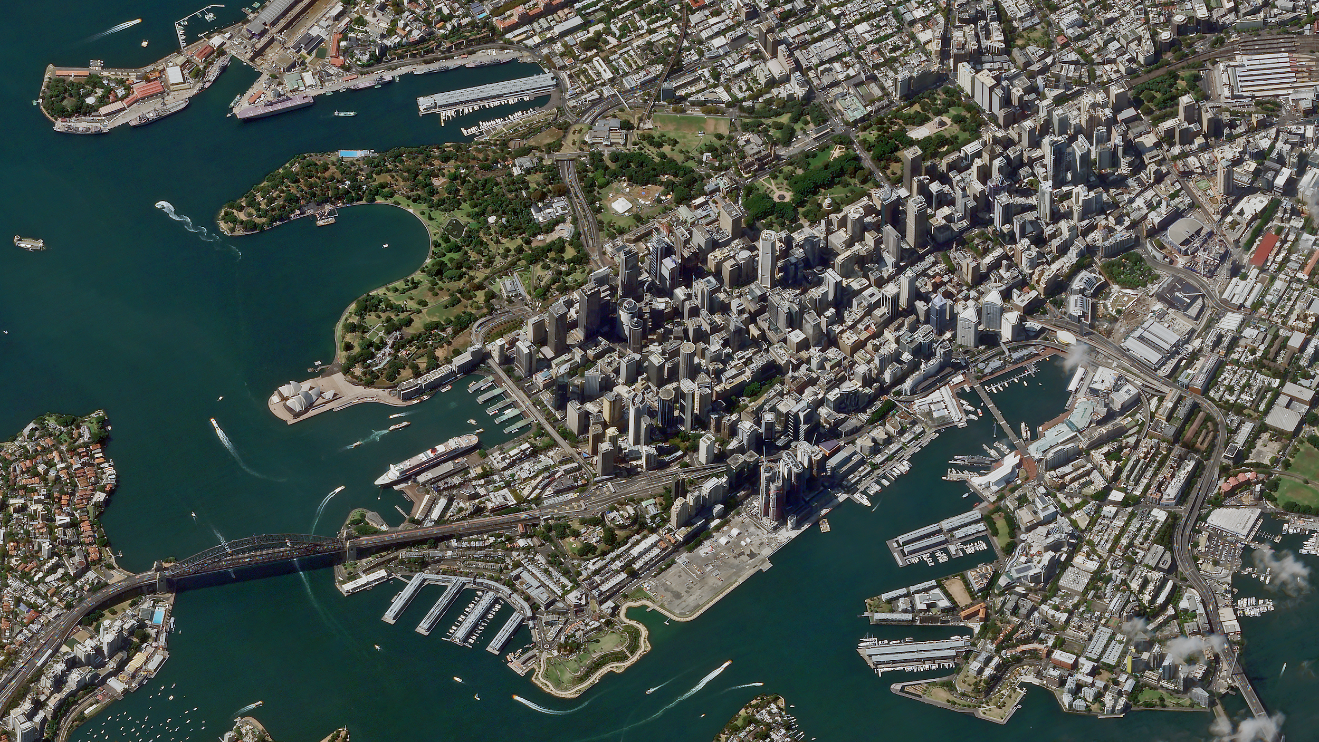
Sydney, Australia

Slide 7

Hold up.
Google has satellites?

Slide 8
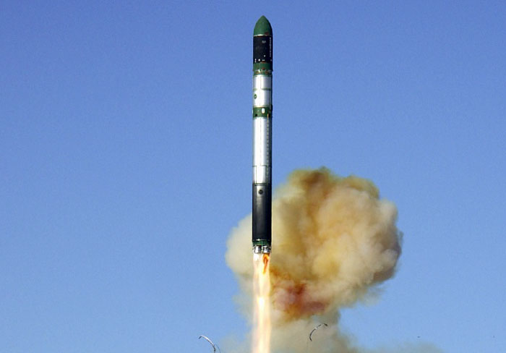
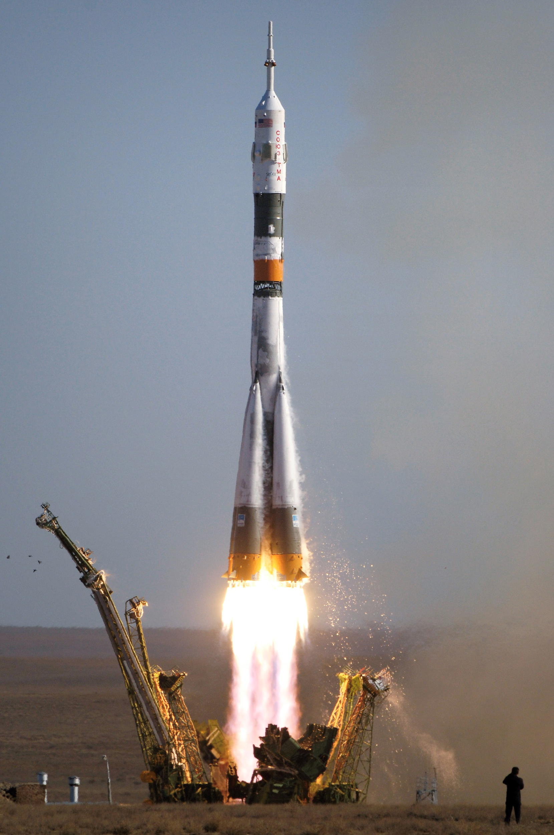
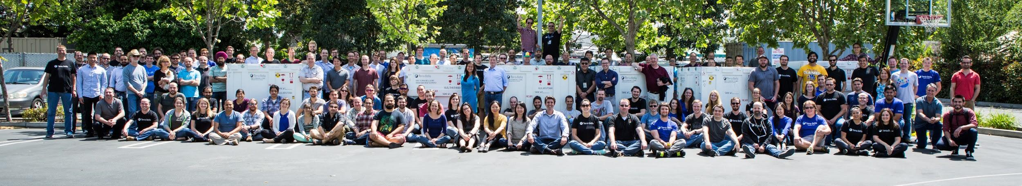
Terra Bella at a glance
SS-1 Launch Yasny, RU (Nov. 2013)
SS-2 Launch Baikonur Cosmodrome (July. 2014)
2009: founded by 4 Stanford grad students
2014: Google Acquisition
~190 person team
Vertically integrated
2 satellites in orbit, operated 24x7 from MTV

Slide 9
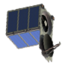
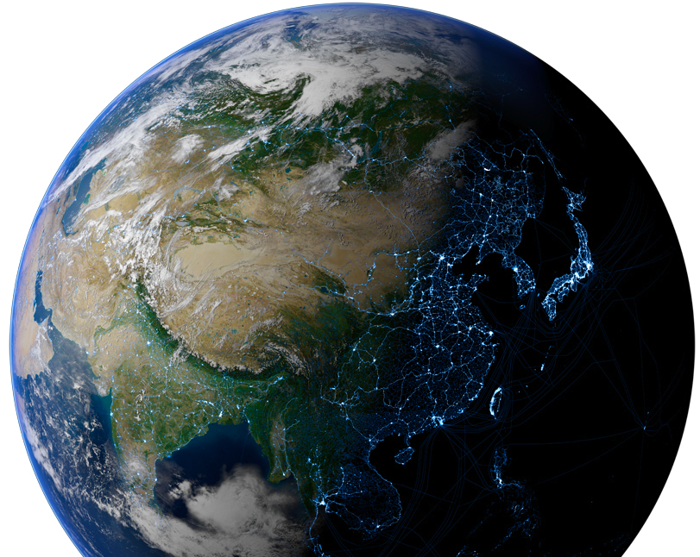
Today

Slide 10
2016

Slide 11
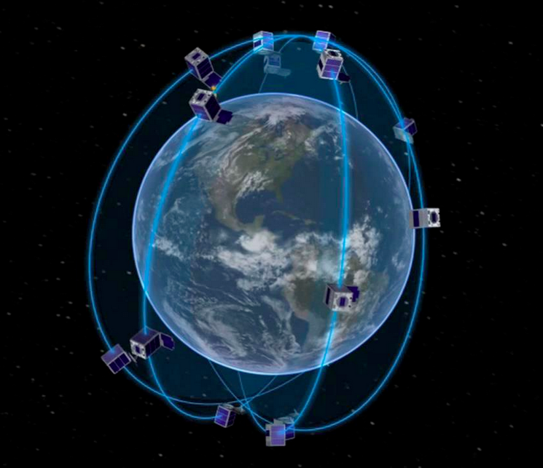

Slide 12
Okay, that’s pretty cool.
But what are you doing with all those images?

Slide 13
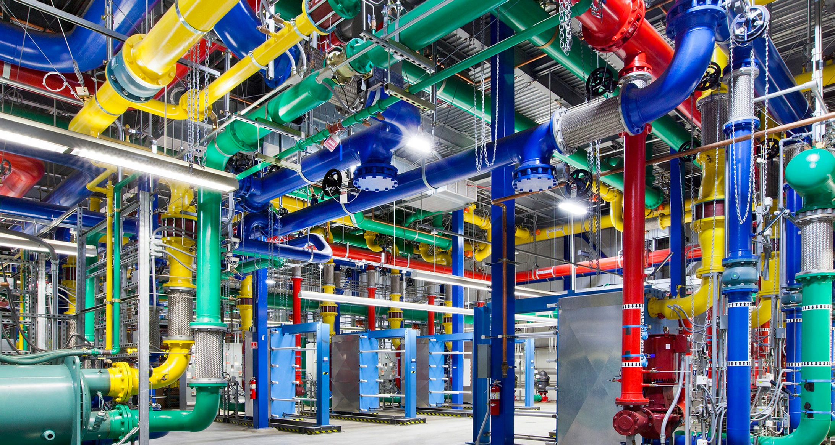
Google’s mission is to organize the world’s information and make it universally accessible and useful.

Slide 14
Pioneering the search for patterns of change in the physical world to help address global economic, environmental, and humanitarian challenges.

Slide 15
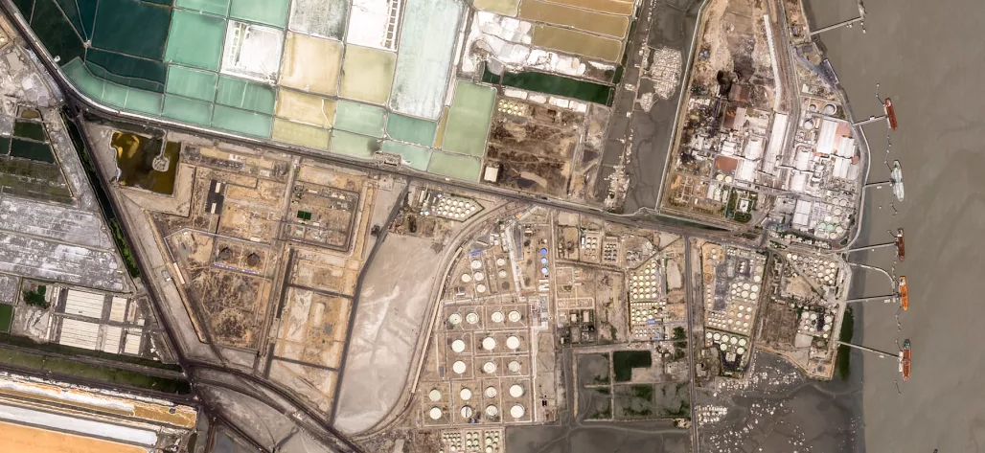
Our goal
Translate satellite imagery into something easily understood by global decision-makers

Slide 16
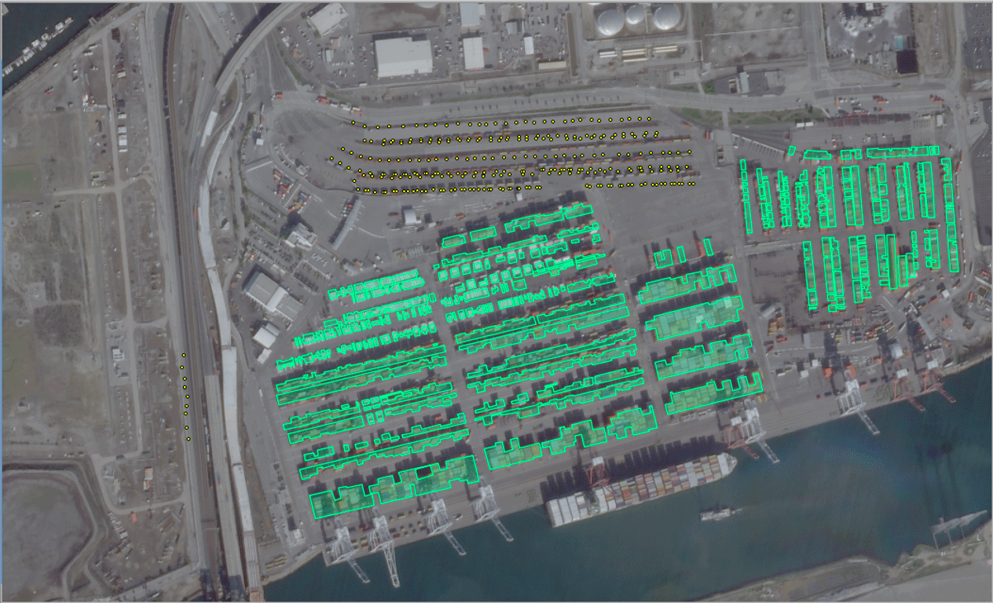

Slide 17
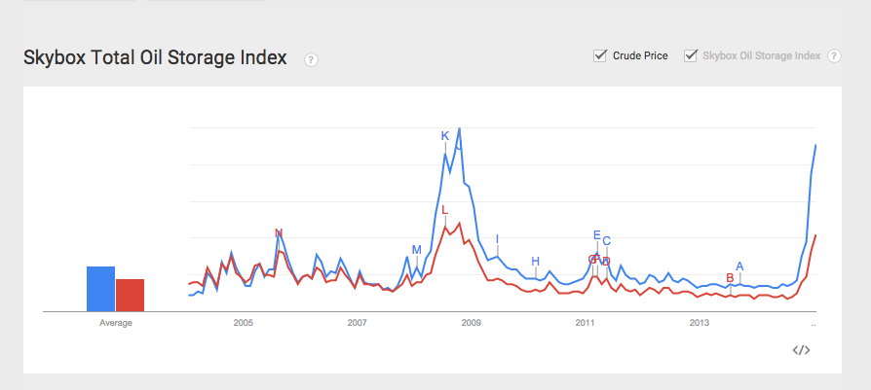
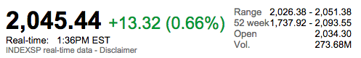
Container Flow
Disclaimer: This is an example.
December
January
February
March
April

Slide 18
What are the potential use cases?

Slide 19
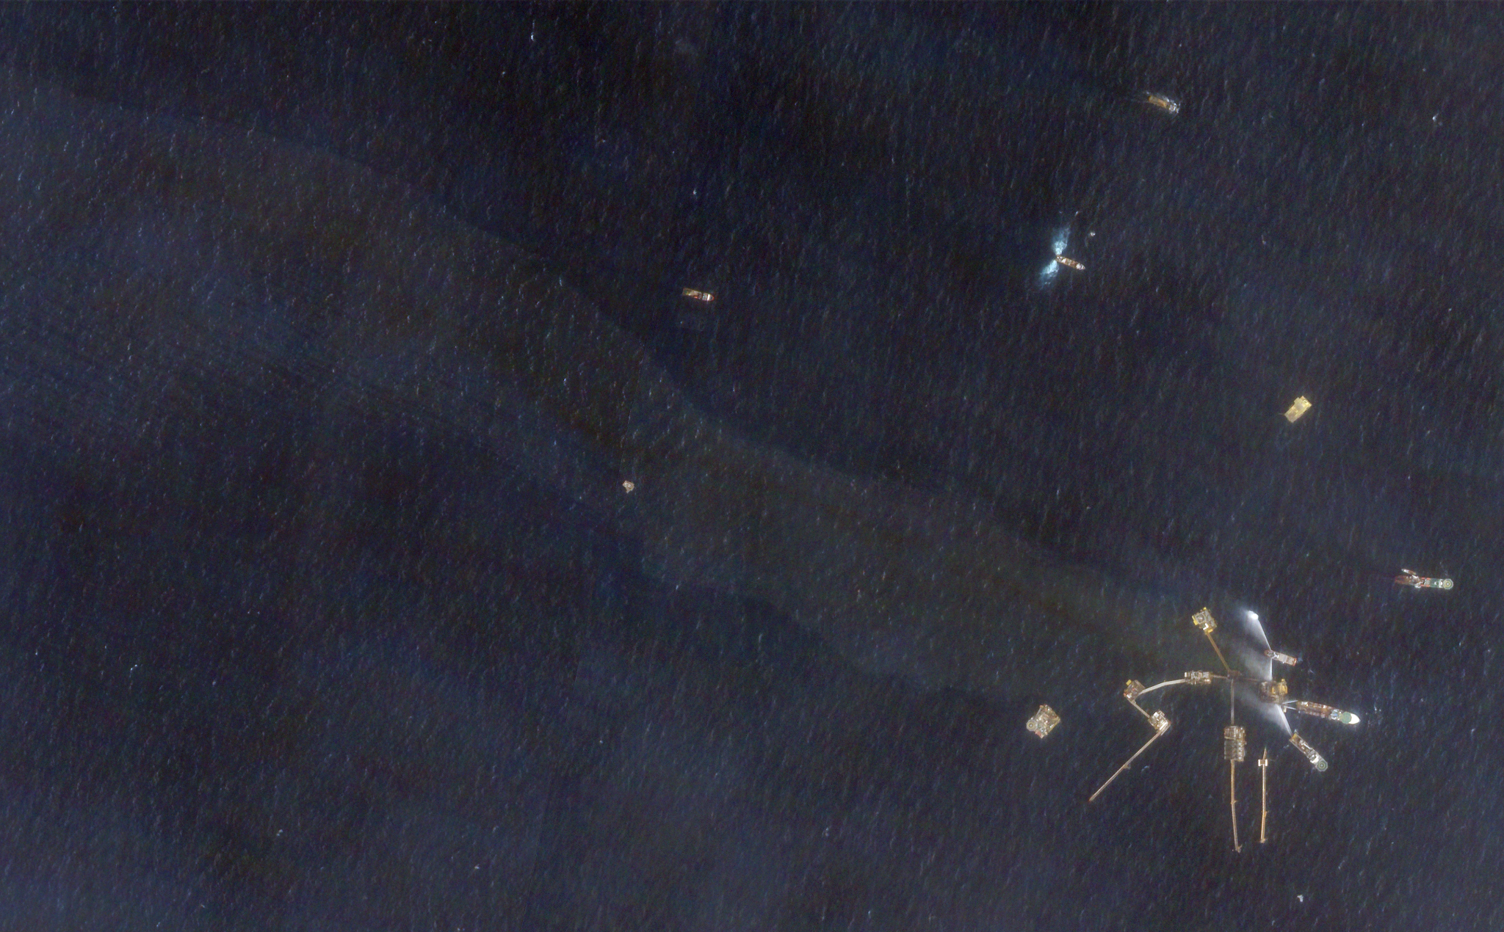
Humanitarian use cases
Partner | Application
Halo Trust | Landmine Clearance in Sri Lanka
Joint Research Centre | Monitoring Forest Degradation
Harvard Humanitarian Initiative | Automated IDP Camp Monitoring
U.C.S.F. Global Health Group | Malaria prediction
Save the Elephants | Monitoring Human Footprint and Environment in Northern Kenya

Slide 20
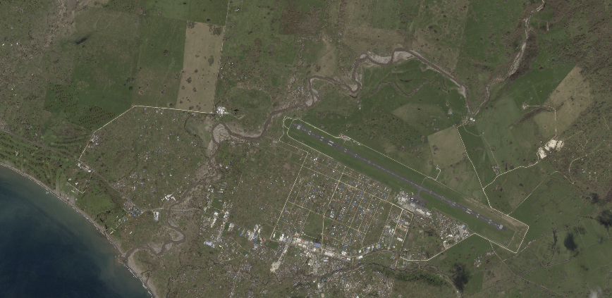
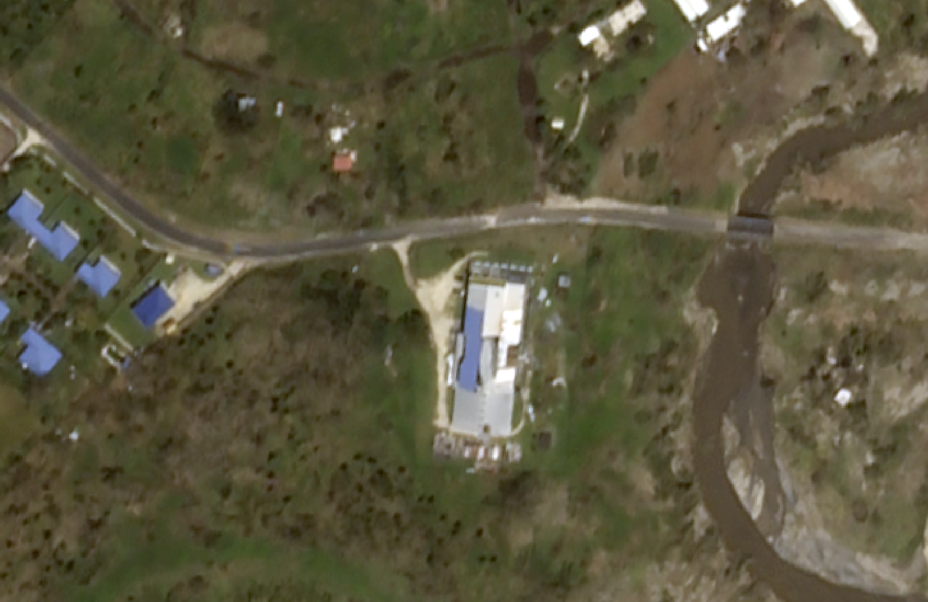
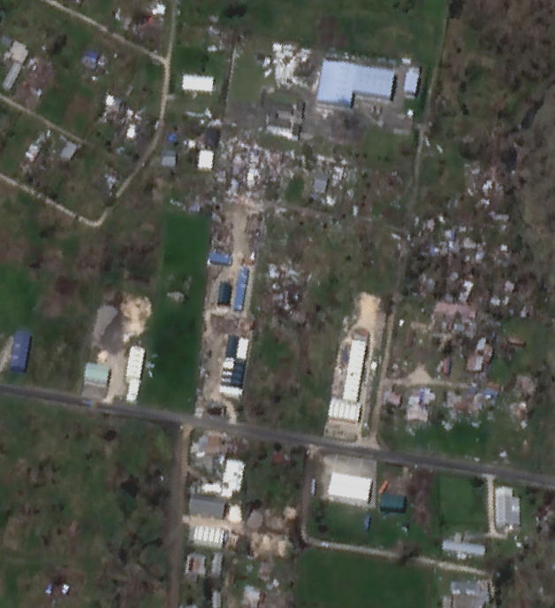
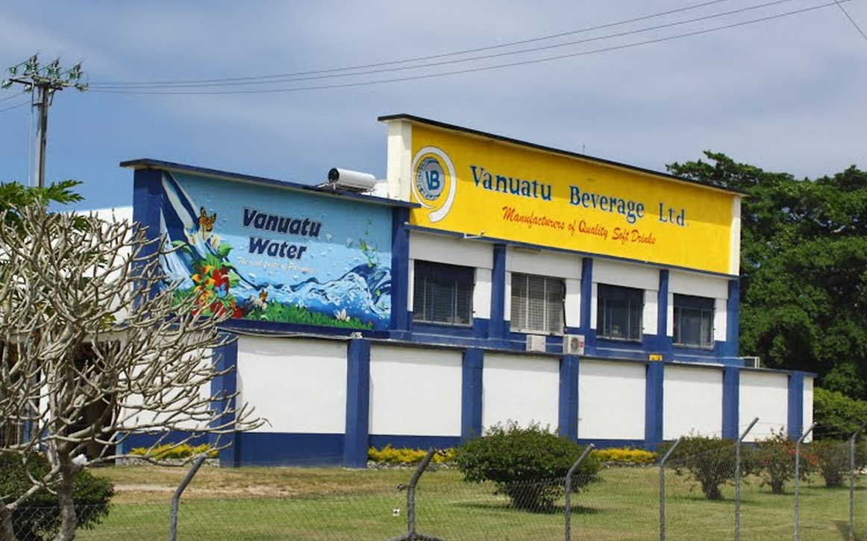
Imaging pre- and post- natural disasters
Riverbank recently flooded
Company Storefront
Mele Town
Significant structural damage observed at the Vanuatu Beverage Company east of the city center
Port Vila
Industrial buildings throughout the riverways in Port Vila showed significant damage, while many adjacent residences appear to have been destroyed entirely.
Structural debris observed throughout this residential / industrial area on the banks of La Colle River
Damage, Debris

Slide 21
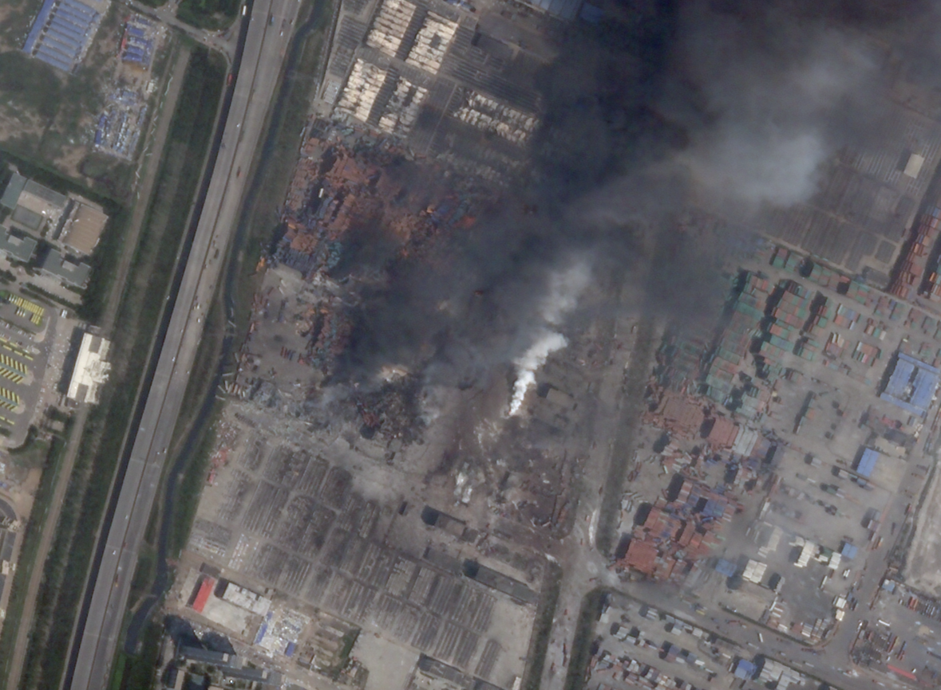
Assessing damage in human disasters
“New York reinsurance broker Guy Carpenter & Company uses Terra Bella imagery to estimate that it may cost $3.3 billion to cover the extent of losses associated with the Tianjin explosions”
"While access to the site is limited, Guy Carpenter’s satellite-based catastrophe evaluation service, was able to use high resolution pre- and post-event satellite imagery to understand what exposures were present at the time of the blast and therefore could contribute to the loss."
http://www.maritime-executive.com/

Slide 22
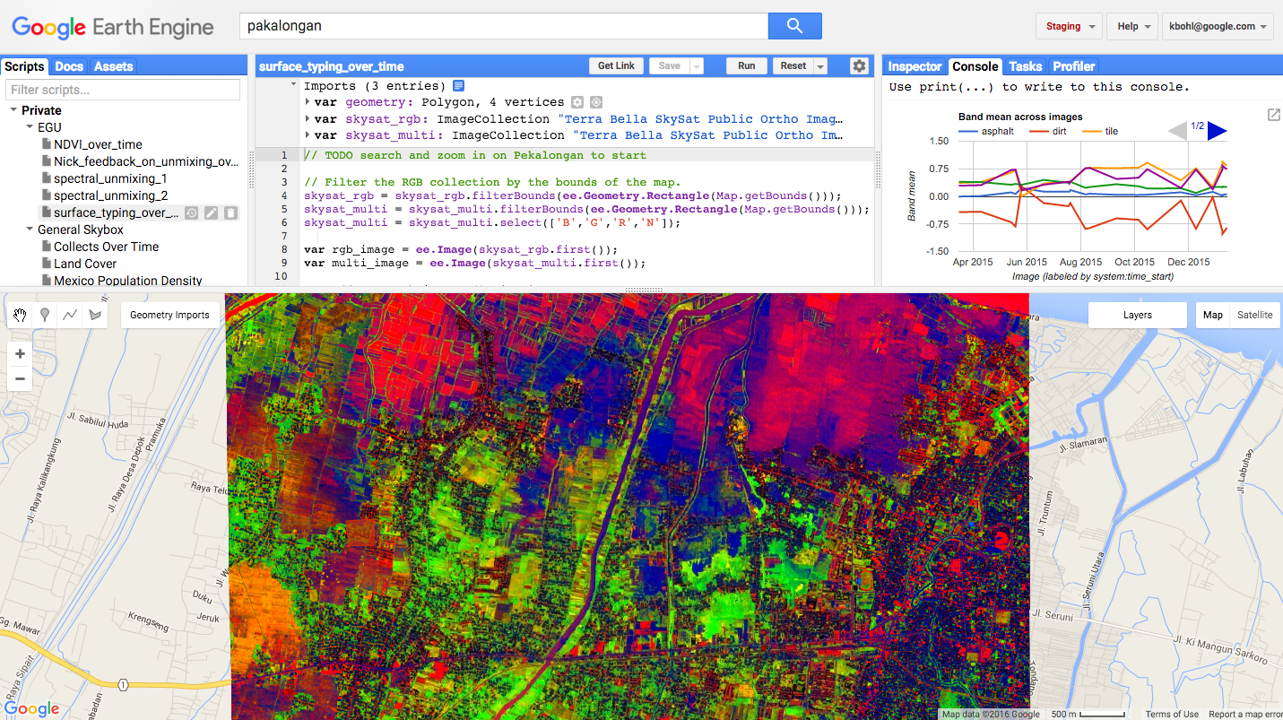
Surface-typing over time in Indonesia

Slide 23
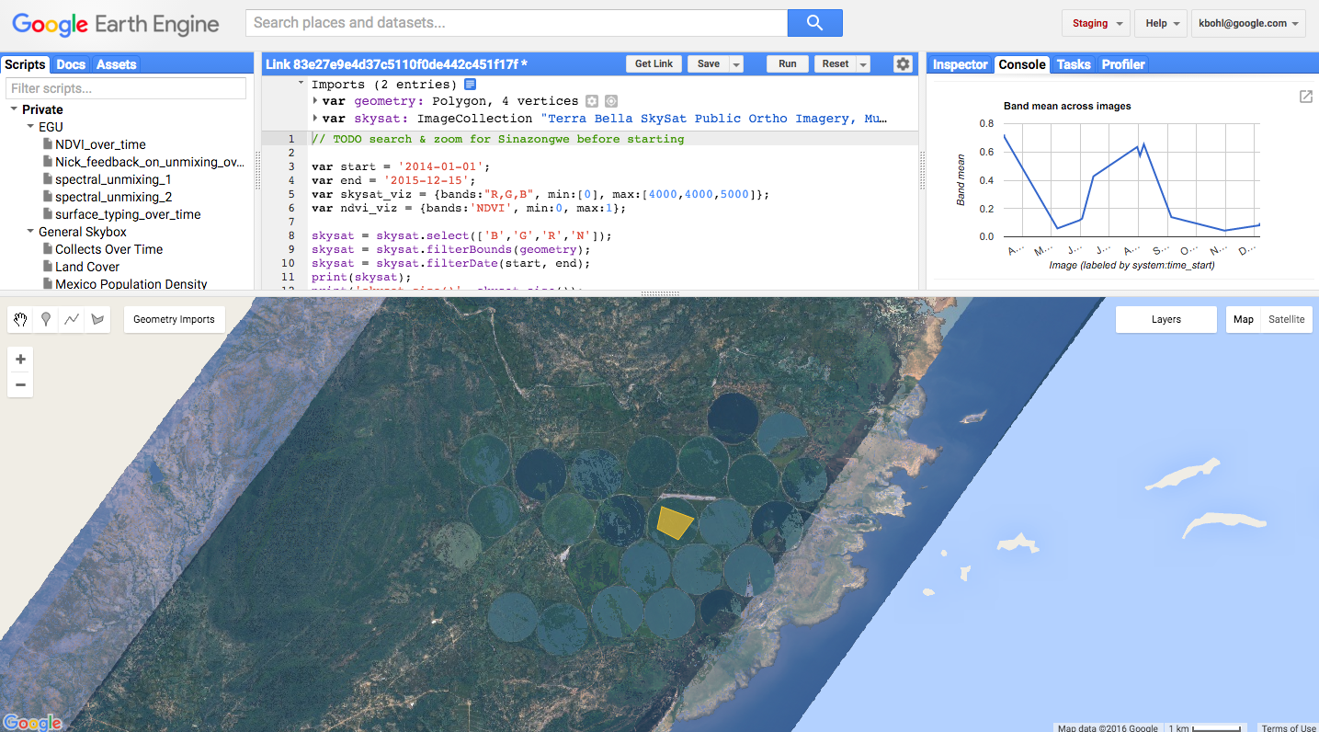
NDVI tracking over time in Zambia

Slide 24
Speaking of images…
can we have some?

Slide 25
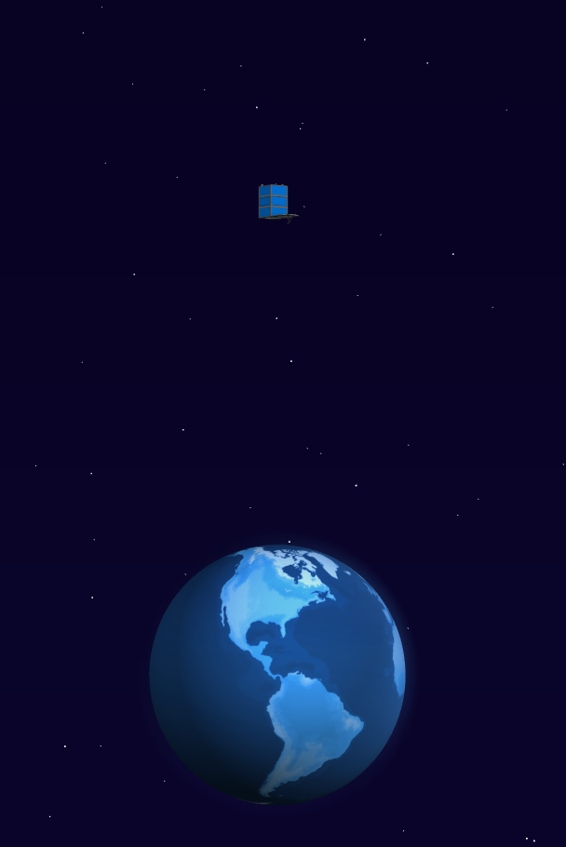
SkySat public imagery
SKYSAT/GEN-A/PUBLIC/ORTHO
/RGB
Three pansharpened, 8-bit bands: Red, Green, Blue
Resolution: ~0.8 m per pixel (closer to 1 m off-nadir)
/MULTISPECTRAL
Five 16-bit bands:
Blue (450-515 nm)
Green (515-595 nm)
Red (605-695 nm)
Near-Infrared (740-900 nm)
Panchromatic (450-900 nm)
Resolution:
B, G, R and Near-IR: ~2m per pixel,
Pan: ~0.8 m per pixel (closer to 1 m off-nadir)
Data type: 16-bit, shifted up from original 12-bit

Slide 26
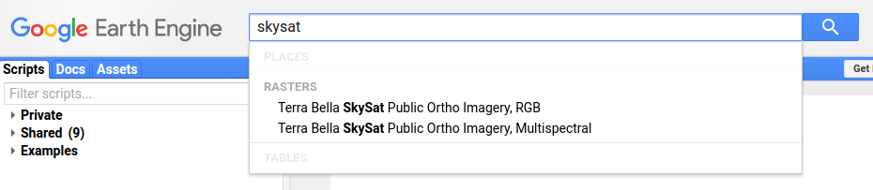
SkySat public imagery

Slide 27
Can we look at pretty pictures again?

Slide 28
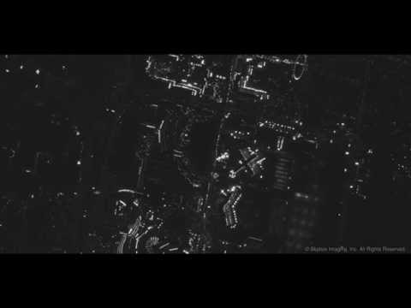
Las Vegas by night

Slide 29
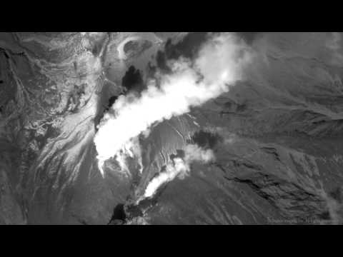
Mount Ontake

Slide 30
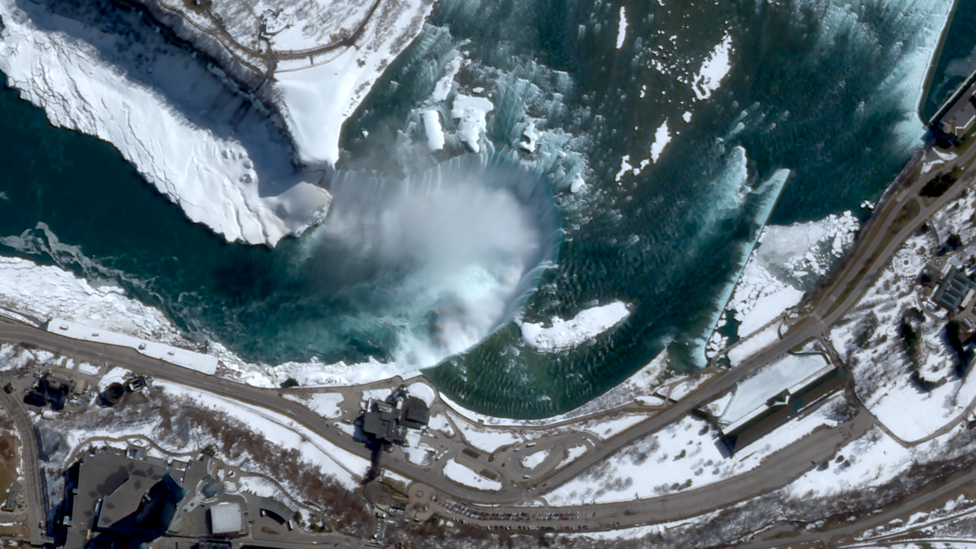
Niagara Falls

Slide 31
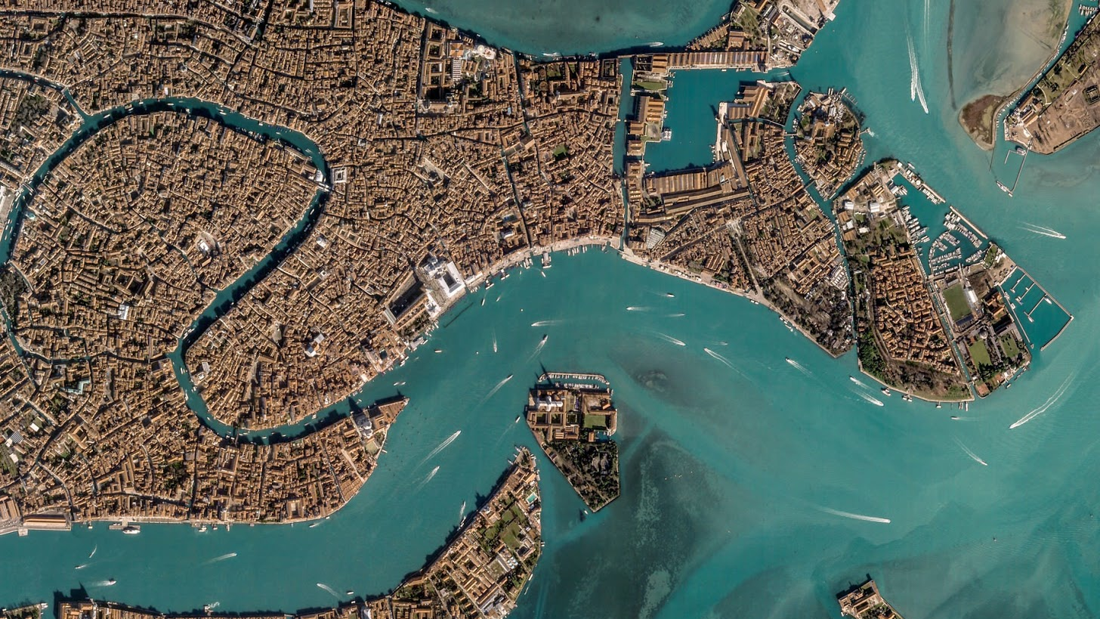
Questions?
More info at google.com/terrabella

